Slide 1
TRAFFIC SIGNAL MANAGEMENT
ASSIGNMENT 1
NAME: A. Lasya
REG NO: 192371090
SUB: Java
SUB CODE: CSA0990

Slide 2
Scenario: You are part of a team working on an initiative to optimize traffic signal management in a busy city to reduce congestion and improve traffic flow efficiency using smart technologies.
Technology: Microphone sensors
INTRODUCTION:
Microphone sensors, also referred to as acoustic sensors or sound sensors, are integral components in modern traffic signal management systems due to their ability to capture real-time audio data from the surrounding environment .Their role extends beyond mere sound detection; they contribute significantly to optimizing traffic flow, enhancing safety, and improving overall efficiency in urban traffic management.
In short, microphone sensors are a smart tool that helps cities manage traffic better, keep people safe, and make the environment cleaner. They play a crucial role in creating a smoother and more efficient traffic system.

Slide 3
TYPES OF MICROPHONE SENSORS – In traffic signal management, different types of microphones can be used depending on the specific application and environmental conditions. Here are some common types: 1. Omni-directional Microphones: - These microphones capture sound from all directions equally. - Application: Omni-directional microphones are suitable for general traffic monitoring where capturing ambient noise levels and overall traffic patterns is important. 2. Directional Microphones: - These microphones focus on capturing sound from a specific direction or angle. -Application: Directional microphones are useful in scenarios where identifying specific sounds, such as sirens or horns from approaching emergency vehicles, is critical for making real-time adjustments to traffic signals. 3. Array Microphones: - Array microphones co microphones can be used to enhance directionality and noise cancellation, making them effective in noisy environments consist of multiple microphone elements arranged in a specific configuration. - Application: Array or for pinpointing sound sources with greater accuracy.

Slide 4
4. Boundary Microphones: - These microphones are designed to be placed on flat surfaces such as walls or ceilings. - Application: Boundary microphones are suitable for installation in fixed locations at intersections or along roadways, where they can effectively capture ambient traffic noise and vehicle movements. 5. Weatherproof Microphones: - These microphones are designed to withstand outdoor conditions such as rain, wind, and temperature fluctuations. - Application: Weatherproof microphones are essential for reliable operation in all weather conditions, ensuring continuous data capture for traffic management systems. 6. Microphones with Noise Cancellation: - These microphones use advanced signal processing techniques to reduce unwanted background noise. - Application: Microphones with noise cancellation capabilities are beneficial in urban environments with high ambient noise levels, helping to improve the accuracy of sound detection and analysis.

Slide 5
DATA COLLECTION AND MODELLING
1. Collecting Data
A. Traffic Flow Data
What It Is: How many cars are on the road and how fast they’re going.
How to Collect: Use sensors in the road, cameras, and radar to gather this info.
B. Signal Status Data
What It Is: Information about traffic light timings (red, green, yellow).
How to Collect: Get data from traffic light controllers and central systems.
C. Environmental Data
What It Is: Weather and air quality info that affects traffic.
How to Collect: Use weather stations and air quality sensors.
D. Incident Data
What It Is: Details about accidents or road closures.
How to Collect: Check emergency alerts and traffic reports.
E. User Data
What It Is: Feedback from drivers and info from navigation apps.
How to Collect: Use app data and surveys.

Slide 6
2. Creating Models A. Traffic Demand Modeling What It Is: Predicting future traffic based on past data. How to Do It: Use historical data and machine learning tools. B. Signal Timing Optimization What It Is: Finding the best times for traffic lights to reduce delays. How to Do It: Use mathematical methods or smart algorithms. C. Traffic Simulation What It Is: Testing traffic scenarios in a virtual model. How to Do It: Use simulation software like VISSIM. D. Incident Management What It Is: Handling traffic disruptions from accidents or closures. How to Do It: Use models to plan for rerouting traffic.

Slide 7
3. Testing and Adjusting a. Pilot Testing What It Is: Trying out new signal timings in a small area first. How to Do It: Test different plans and gather feedback. b. Continuous Monitoring What It Is: Regularly checking and adjusting traffic signals. How to Do It: Use real-time data and adaptive systems to make ongoing changes.
E. Smart Technology Integration What It Is: Using technology to make traffic management smarter. How to Do It: Connect sensors, use cloud computing, and apply AI for real-time adjustments.

Slide 8
Algorithm - GreenWave
Input: road Network, signal Timing
Output: optimized Signal Timing
1. Define the parameters:
- road Network: A graph representing the intersections and roads.
- signal Timing: Initial timing settings for traffic signals.
2. Initialize the parameters:
- desired Speed: Desired speed for vehicles (e.g., 50 km/h).
- cycle Time: Total time for one complete cycle of the traffic signal (e.g., 120 seconds).
- offset: Time difference to create the green wave.
3. Calculate the travel time between intersections:
For each road segment in road Network:
travel Time = distance / desired Speed

Slide 9
4. Adjust signal timings to create the green wave: For each intersection in road Network: For each direction in intersection: Calculate offset based on travel Time to the next intersection: offset = travel Time % cycle Time Set the green light start time for the direction: green Start Time = previous Green End Time + offset Ensure green light duration: green End Time = green Start Time + green Duration 5. Ensure synchronization across intersections: For each intersection in road Network: For each adjacent intersection: Align the green Start Time with the offset calculated for synchronization. 6. Update the signal timing settings: For each intersection in road Network: Update signal Timing with the new green Start Time and green End Time. 7. Output the optimized signal timing: Return optimized Signal Timing End Algorithm

Slide 10
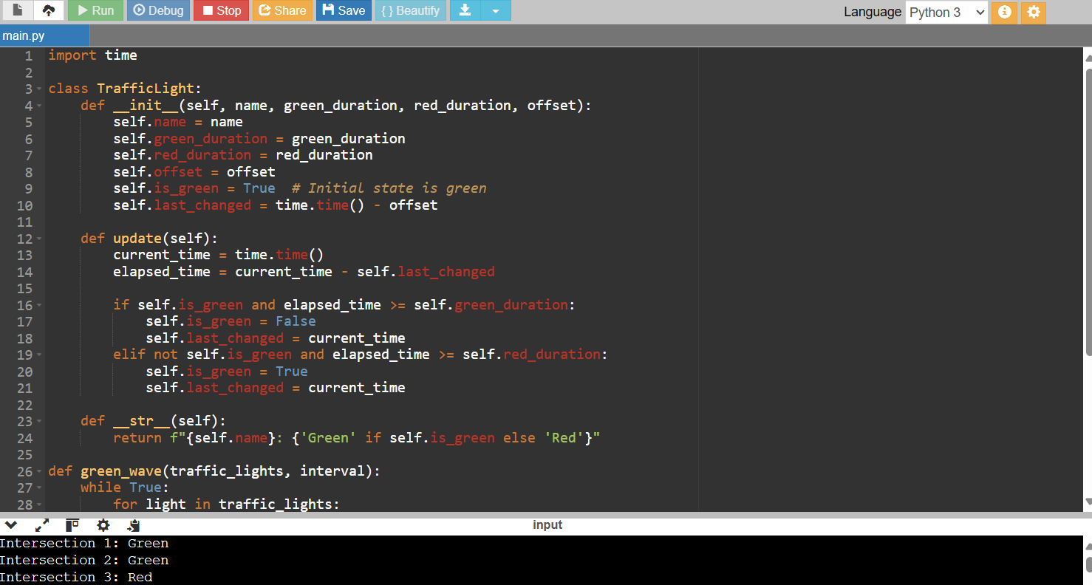

Slide 11
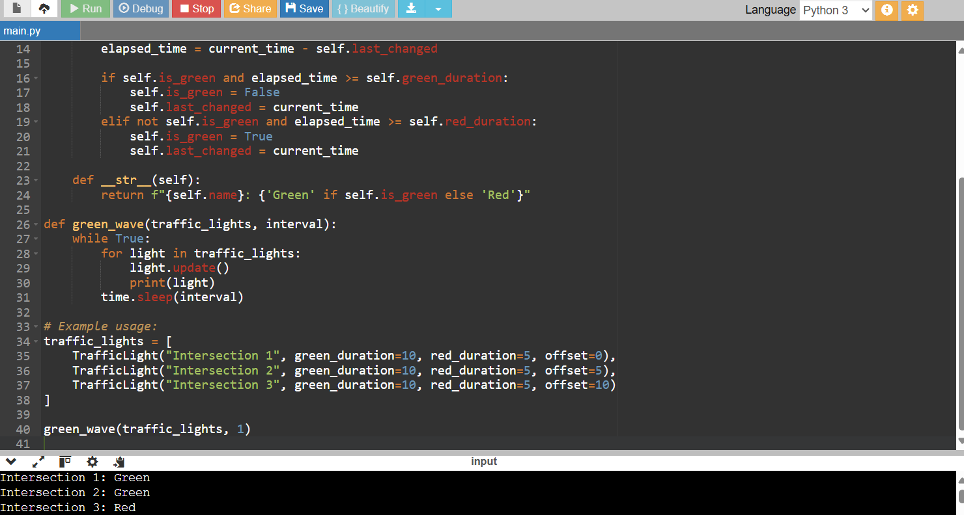

Slide 12
IMPLEMENTATION
1. Microphone Sensors for Traffic Detection
a. Installation and Calibration:
Choose Locations: Place sensors at busy intersections.
Mount Sensors: Secure them in place and protect from weather.
Calibrate: Adjust to accurately pick up vehicle sounds and ignore background noise.
b. Data Collection:
Process Audio: Use software to identify vehicle sounds.
Recognize Patterns: Apply machine learning to detect traffic volume and types of vehicles.
c. Integration with Traffic Signals:
Set Up Communication: Ensure sensors can send data to traffic signals.
Real-time Data: Feed real-time traffic information to the signal control system.

Slide 13
2. Green Wave Algorithm a. Design the Algorithm: Parameters: Consider speed limits, traffic volume, and distances between lights. Synchronization: Create rules for timing lights to keep traffic flowing smoothly. b. Implement the Algorithm: Develop Code: Write software to control light timings based on traffic data. Integrate : Make sure the algorithm works with existing traffic signal systems. c. Testing and Optimization: Simulations : Test the algorithm using traffic simulation software. Field Tests: Implement in a small area and monitor performance. Refine : Adjust based on test results

Slide 14
Tools and Technologies Microphone Sensors: Sensitive and weather-proof. Audio Processing Software: Tools like MATLAB or Python libraries. Machine Learning: Use models to classify vehicle sounds. Traffic Signal Controllers: Systems to manage light timings. Simulation Software: VISSIM or SUMO for testing the algorithm.
Future Scope of Microphone Sensors and Green Wave Algorithm
The future of using microphone sensors and the green wave algorithm for traffic signal optimization includes real-time adaptive signals, predictive analytics, and integration with smart technologies like vehicle-to-infrastructure communication. Expanding sensor types to include cameras and environmental monitors will enhance traffic and pollution management. Urban planning will benefit from data-driven decisions and scalability to larger areas. Public engagement through real-time traffic apps and community feedback will improve strategies. Continuous research will drive innovative algorithms, leading to reduced congestion, lower emissions, improved safety, and economic efficiency, contributing to smarter and more efficient urban traffic management.

